Slide 1

Polypharmacy in Israeli older adults:
A geriatrician’s perspective
Shelley A. Sternberg MD, MSCE, FRCPC
Regional Director of Geriatrics, Maccabi Healthcare Services
Director, Memory Clinic, Shaare Zedek Medical Center
13.03.25

Slide 2

Definitions
Background
Israeli data
Interventions
Outline

Slide 3

What is polypharmacy?
WHO – concurrent use of multiple medications
CDC – 5 or more medications (8 or more)
NHS – use of multiple medications by one individual – can be appropriate or inappropriate
WHO Medication Safety in Polypharmacy (2019) https://www.who.int/docs/default-source/patient-safety/who-uhc-sds-2019-11-eng.pdf
Polypharmacy and Health-Related Quality of Life/Psychological Distress Among Patients With Chronic Disease(2022) https://pmc.ncbi.nlm.nih.gov/articles/PMC9390791/pdf/PCD-19-E50.pdf
3) Understanding polypharmacy, overprescribing and deprescribing (2022) https://www.sps.nhs.uk/articles/understanding-polypharmacy-overprescribing-and-deprescribing/

Slide 4


Improve life expectancy and QOL
Risks and harm outweigh benefits

Slide 5
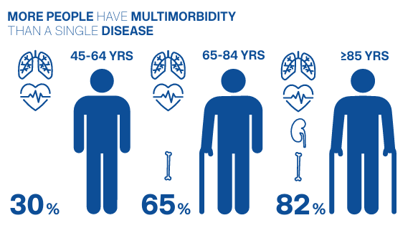
Notes:
‘Stimulating Innovation Management of Polypharmacy and Adherence in the Elderly’, is funded by the European Commission through EU Health Programme 2014–2020. The project is being delivered by a consortium of 10 institutions from eight European countries. The objective of SIMPATHY is ‘to stimulate and support innovation across the EU in the management of polypharmacy and adherence in the elderly, with specific focus on addressing inappropriate polypharmacy’.

Slide 6
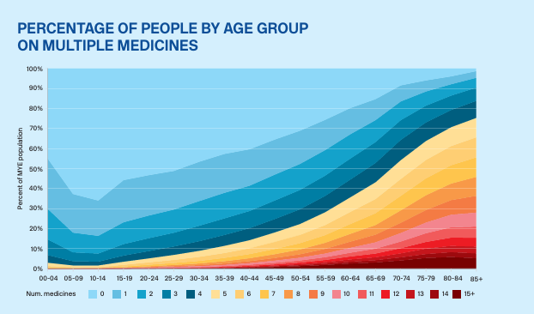

Slide 7
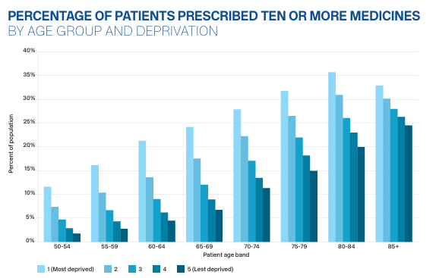

Slide 8
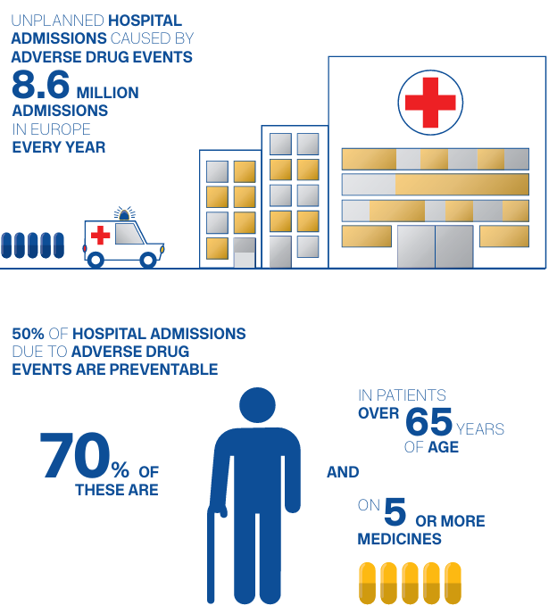

Slide 9
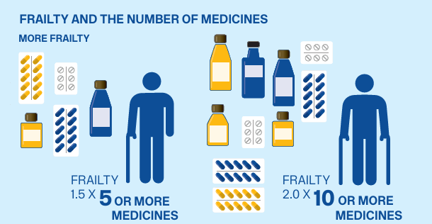

Slide 10
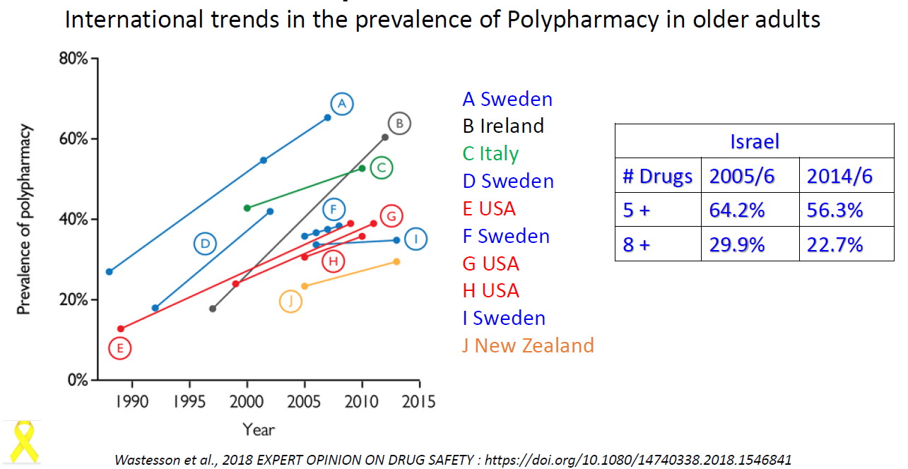

Slide 11
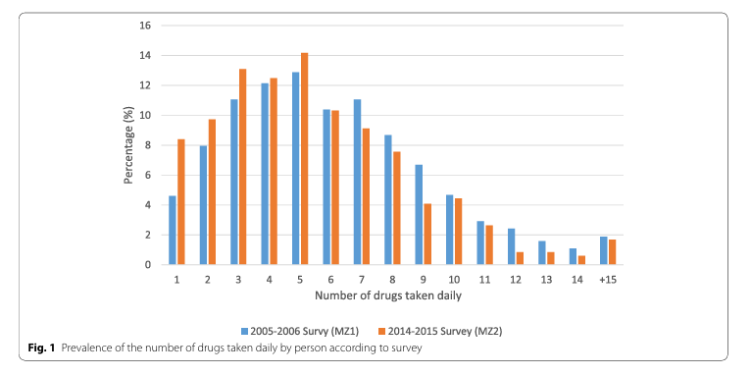
Number of daily drugs in >65yo in Israel
Goldsmith et al. BMC Geriatrics 2022;22:502
Notes:
Data from MABAT national health survey cross sectional in 2005 and 2015 time 1 1600, time 2 800

Slide 12
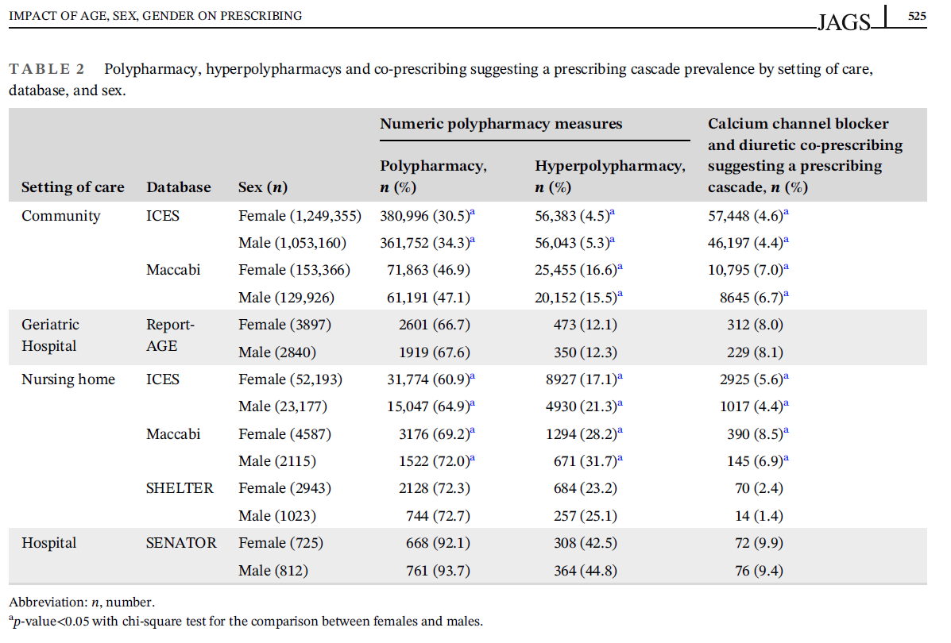
J Am Geriatr Soc. 2025;73:520–532.

Slide 13
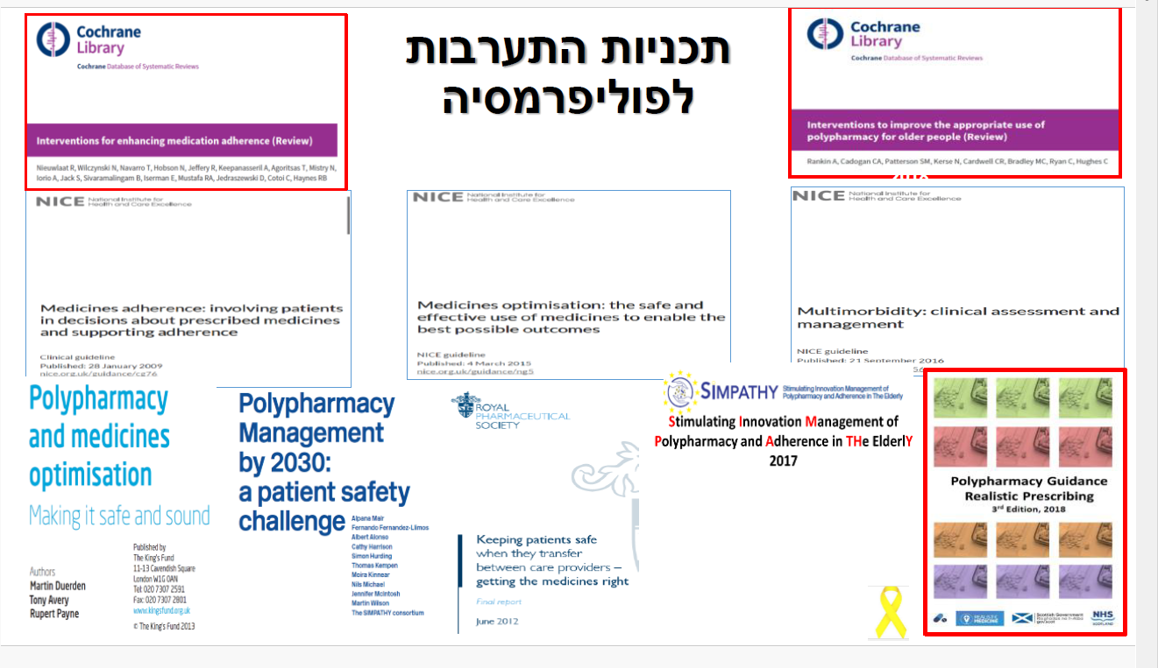
Polypharmacy intervention programs

Slide 14
Policy initiatives re: polypharmacy in Israel
Comptroller general reports 2011 and 2017
National Geriatric Advisory Committee – 3 commissions with publication of a 2017 report of recommendations
Ministry of Health Directives – 2013, 2016, 2019, 2022
Ministry of Health Financial Incentive programs to HMOs
  2016 - Clinical pharmacist consultations
  2022-2024 – Decrease opiate and antibiotic use, improve adherence in chronic disease management
Future plans – National program to address polypharmacy in older adults

Slide 15
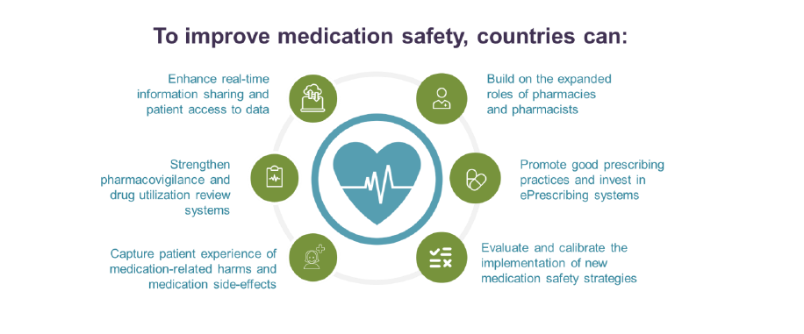
OECD Health Working Papers No.147
The Economics of Medication Safety 2022

Slide 16
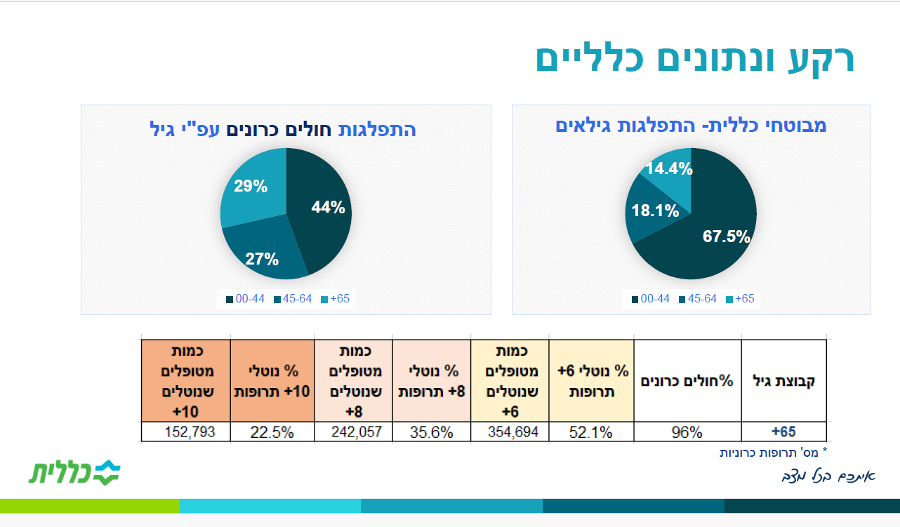
Clalit Healthcare Fund Background Data
Members with chronic diseases by age
Clalit members by age distribution
% taking 10 drugs
% taking 8 drugs
% taking 6 drugs
% Chronic disease
Age

Slide 17
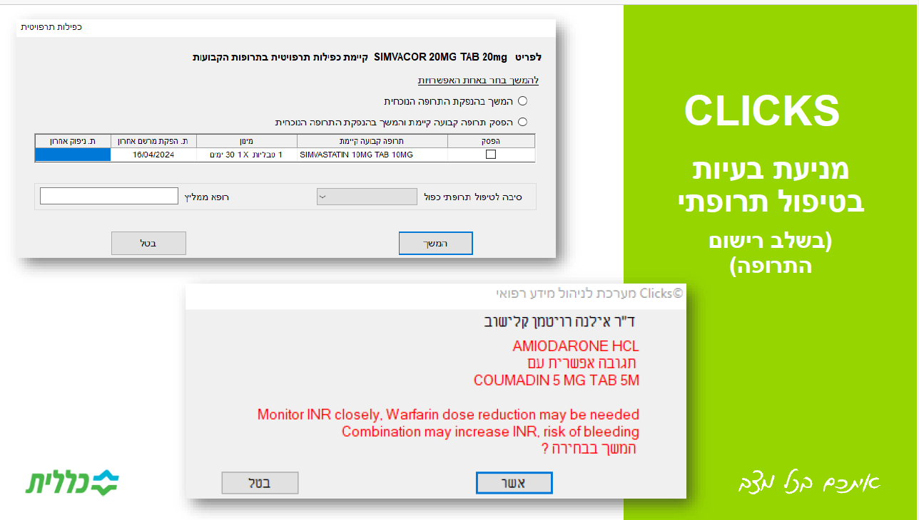
Identifying inappropriate prescribing at the time of prescription using digital modules built into the EMR

Slide 18
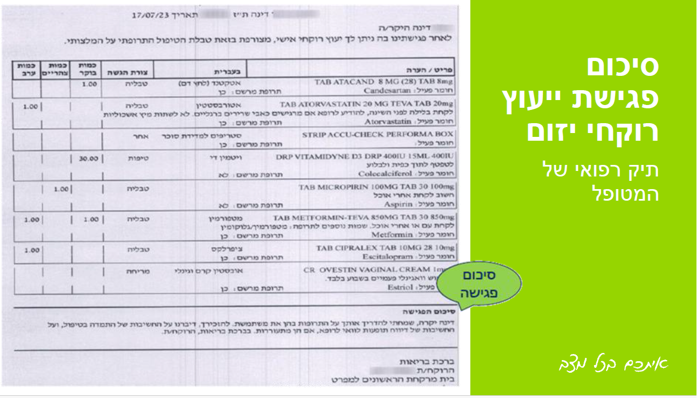
Clinical Pharmacist consultation

Slide 19
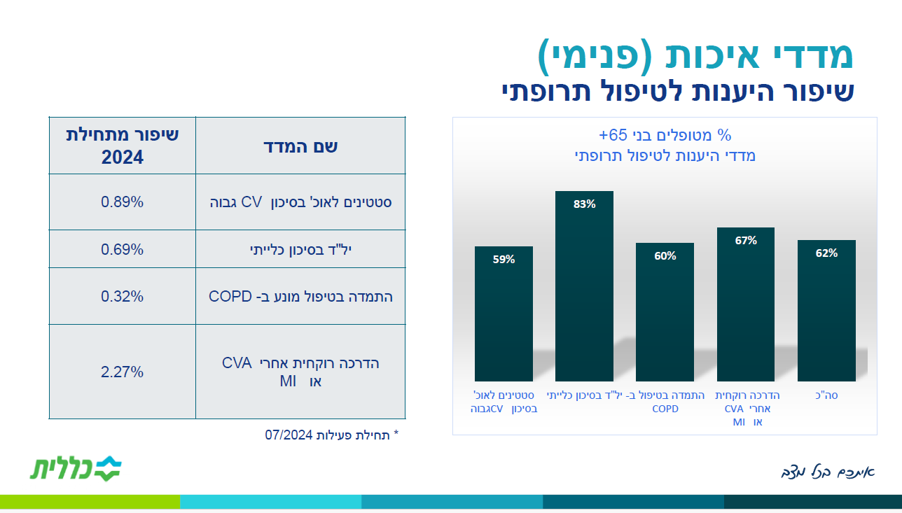
Internal Quality measures:
Improving medication adherence
Improvement in 2024
Name of quality measure
Statins in high risk CV group
HTN RX in CKD
Preventive care in COPD
Pharmacist teaching after MI or CVA

Slide 20
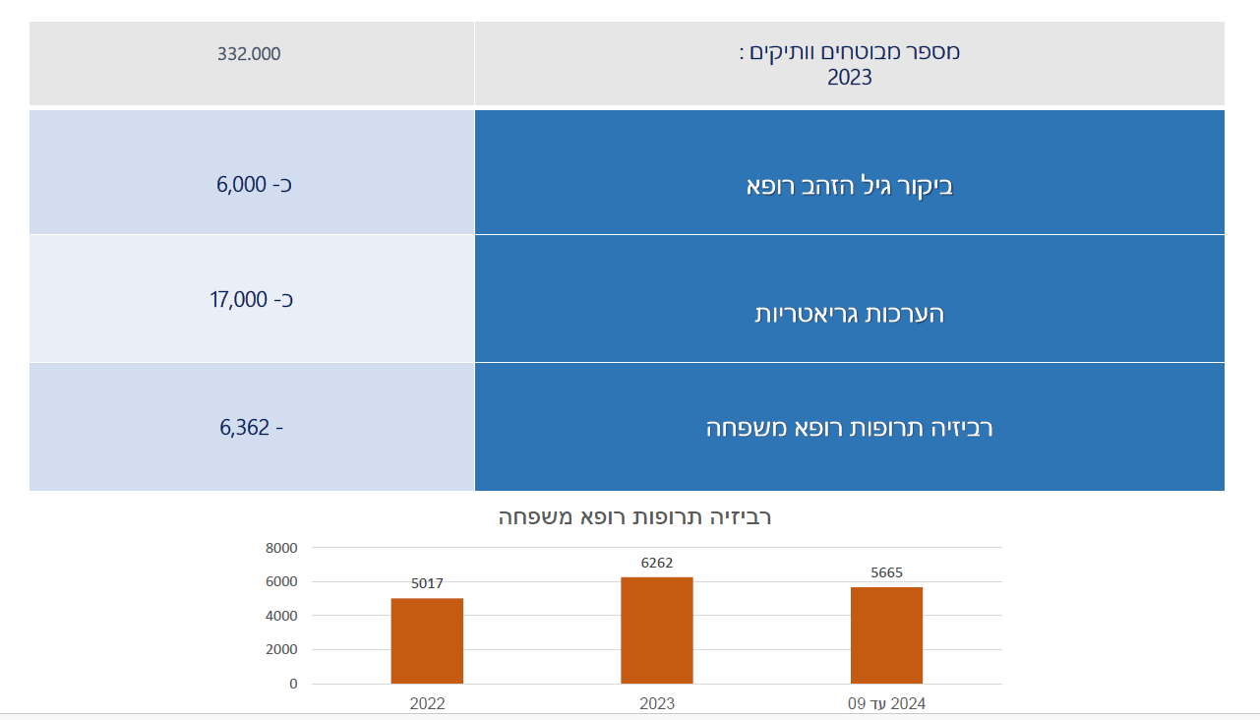
Maccabi Healthcare Services
Members >65, 2023
Golden age visit family physician
Geriatric assessments
Medication review

Slide 21
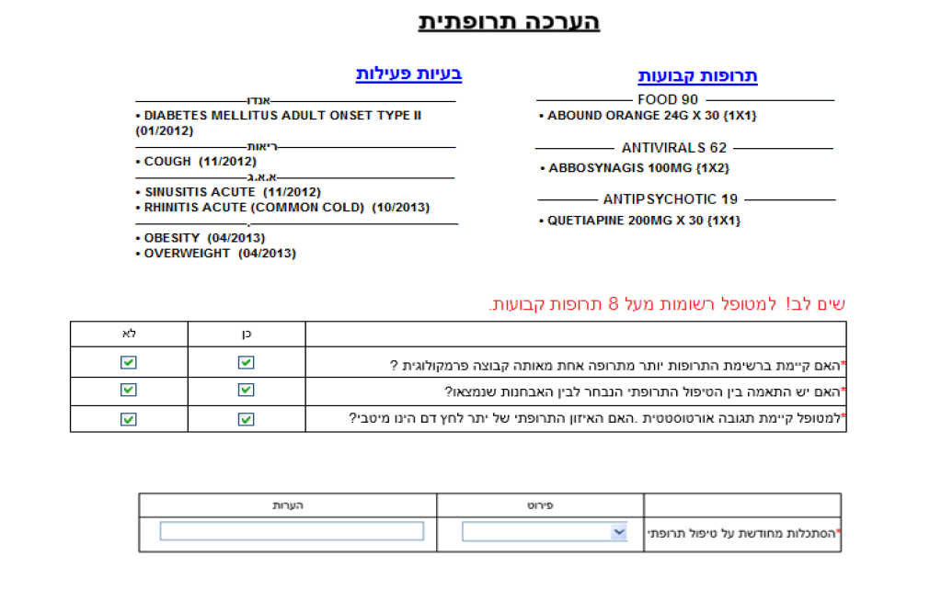
Medication Review
Active Issues
Chronic Medications
Please note! This pt has more than 8 chronic medications

Slide 22
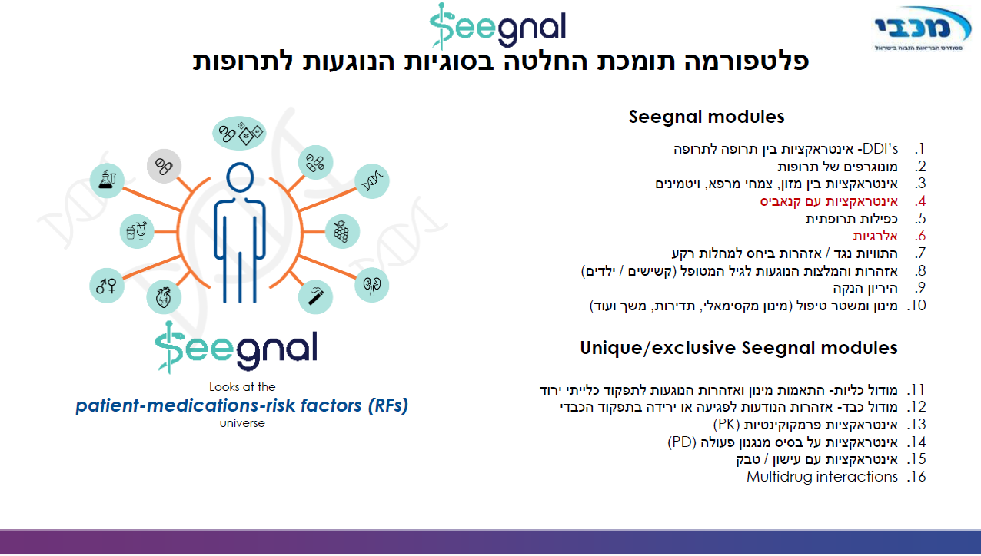
A medication decision support platform

Slide 23
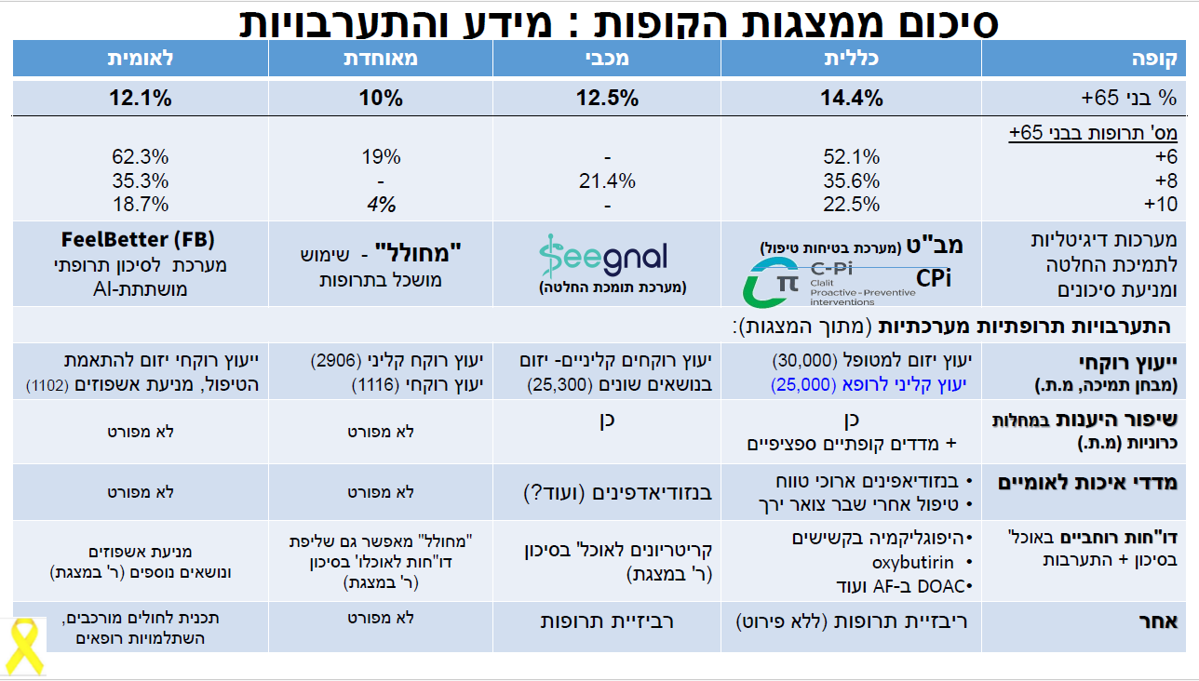
Summary table of HMO polypharmacy interventions
Leumit
Meuhedet
Maccabi
Clalit
HMO
# medications 65+
Digital decision support systems
System-wide interventions
Clinical pharmacist
Clinical pharmacist
Improve adherence in chronic diseases
Use of benzos
Use of benzos
Treatment after hip fx
National quality measures
Hypoglycemia
Regular reporting
Medication review
Medication review
Other

Slide 24
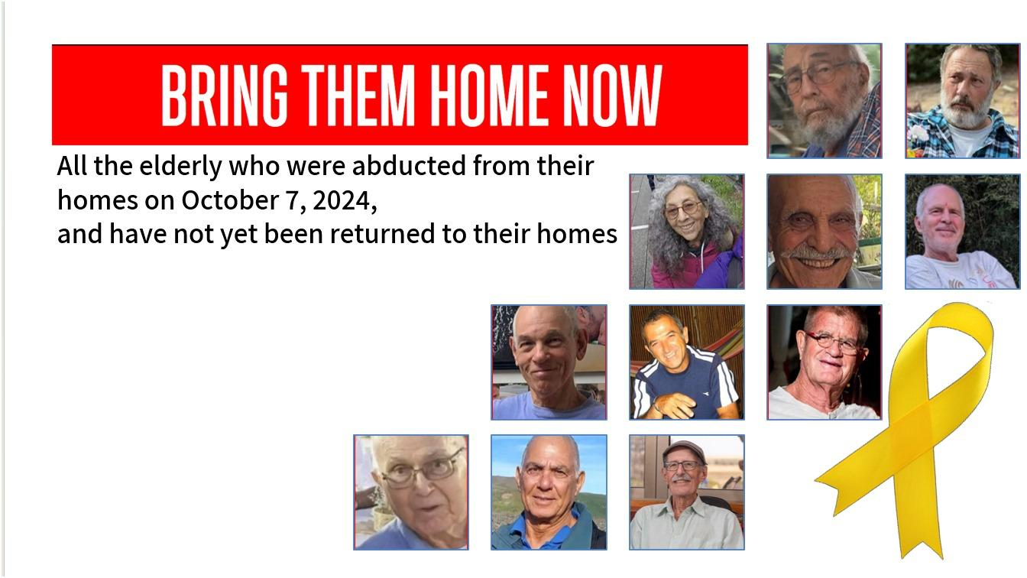
Some of the 33 older adults abducted from their homes by Hamas on October 7, 2023.

Slide 25
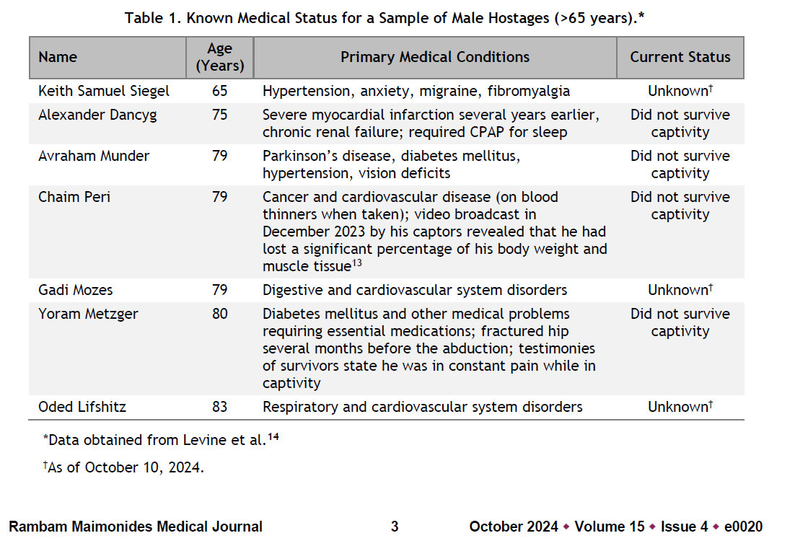
Released
Released
Did not survive
Medications were not provided in captivity

Slide 26
Definitions
Background
Israeli data
Interventions
Summary

Slide 27

Thank you very much

