Slide 1

Polypharmacy
A Geriatric Perspective
Thomas Frühwald
NGO Committee on Ageing
United Nations Vienna

Slide 2
Pharmacotherapy in old age
What makes (still) sense?
Deprescribing
Contents:
EbM and ist dilemma with geriatric patients
Polypharmacy, PIM
MAI, Beers List, STOPP/START, PRISCUS, FORTA, Austrian PIM LIst
Optimizing pharmacotherapy in old age
Priorization, Deprescribing, Choosing Wisely

Slide 3
Under-,over- or mistreatment
Tinetti ME, Fried T: The End of the Disease Era. Am J Med. 2004, 116 (3): 179-85
“A primary focus on disease, given the changed health needs of patients, inadvertently leads to undertreatment, overtreatment, or mistreatment…”
Undertreatment:
One cause: not treating symptomatic patients who do not fulfill the current diagnostic criteria of a disease
One form: lack of therapeutic interventions considering socio-economic, psychological and environmental causal factors, emphasizing only biological determinants of disease
Notes:
Wegen der offensichtlichen Problematik der inadäquaten Therapien bei Multimorbidität – wenn spezifische Krankheiten einzeln leitliniengerecht behandeltt werden und dann additiv Überbehandlung od. Fehlbehandlung entseht, bzw. aus quasi Resignation Unterbehandlung, proklamierten Mary Tinetti und Terri Fried das Ende der Krankheitsära…
Sie meinen, daß “A primary focus on disease, given the changed health needs of patients” unbbeabsichtigt zur Unter-, Über od, Fehlbehandlung führt…
In deren Verständnis entsteht “Unterbehandlung” durch das Nicht-Behandeln von Pat. die nicht die klassischen diagnostischen Kriterien spezieller Krankheiten erfüllen…
„Unterbehandlung“ kann auch entstehen, wenn nicht-biologische ursächliche Faktoren von Krankheiten nicht beachtet werden, weil nur die klassischen biologischen Determinanten von Krankheiten betont werden...

Slide 4
Under-,over- or mistreatment
Tinetti ME, Fried T: The End of the Disease Era. Am J Med. 2004, 116 (3): 179-85
Overtreatment:
Simultaneous treatment of all diagnosed diseases leads to overtreatment, also to polypharmacy with serious negative consequences
Example:
  90 years old patient with dementia, multimorbidity: orthostatic hypotension with aggresive antihypertensive therapy ➔ fall
  85 years old patient with bronchial carcinoma, strict glyecmic control with insulin and oral antidiabetcs ➔ recurrent hypoglycemia
Mistreatment:
Results when clinical decisions are guided by disease specific outcomes, not by the individual patient‘s preferences...

Slide 5
The End of the Disease Era
Tinetti ME, Fried T. The End of the Disease Era .Am J Med. 2004, 116 (3): 179-85
Strategies for dealing with the limitations of the disease oriented care:
Multidisciplinary geriatric teams, geriatric assessment
The concept of the geriatric syndromes
Integration of palliative care in geriatrics
Clinical decision making guided by individual patient goals
“The time has come to abandon disease as the focus of medical care“
“The concept of individual disease should not be abandoned, but should be better integrated into individually tailored care…”
Notes:
Welche Strategien könnten helfen, die Probleme der “krankheitsorientierten Ära zu überwinden?
Multidisziplinäre geriatrische Teams, die funktionelle Probleme erkennen und behandeln – auf der Basis des Geriatrischen Assesments…
In die Geriarie integrierte Palliative Care
Radikale Patientenorientierung…

Slide 6
Polypharmacy
- a topic for geriatric medicine
Advances in pharmacology sometimes are a double-edged sword:
  Frequently there is improvement in the health status
  But also frequently risks for some patient groups, f.e. the geriatric patients
Polypharmacy:
  There is not an exact quantitative definition...
  Consumption of unnecessary drugs
  It is not so much about the number of drugs, but more about the quality of prescribing
Polypharmacy is unnecessary drug therapy, therapy that is of more harm than benefit ... (Wooten JM. South Med J. 2015:108(2): 97-104)

Slide 7
Polypharmacy
- a topic for geriatric medicine
Polypharmacy – causal factors:
  Multimorbidity (geriatric patients)
  Various physicians
  Various pharmacies
  Many OTC drugs
  Alternative therapies, plant based, „natural“ therapies and supplements
Polypharmacy
  Confuses patients and their carers
  Worsens adherence for imprtant drugs
  Worsens outcomes
  Increases health care costsPolypharmacy
  - a topic for geriatric medicine

Slide 8
Polypharmacy
- a topic for geriatric medicine
Approximately 20% of the 65 + „community dwelling“ population consume more than 10 drugs – following guideline recommendations (Steinman, Hanlon 2010)
Polypharmacy is directly associated with potentially inappropriate medication (PIM) and with non-adherence
Riskfactors for „Inappropriate Prescribing“ (Spinewine 2007):
    age
    multimorbidity
    polypharmacy
    more mehrere prescribing doctors
The incidence of adverse drug events (ADE‘s) rises proportionally with the extent of polypharmacy
5-35% of the 65+ poplulation experience at least one ADE per year
ADE‘s are the cause of 10 to 30% of all hospitalizations in the 65+ population (Onder 2002)

Slide 9
Polypharmacy in the older population
Versorgungs-Report 2012, Schwerpunkt Gesundheit im Alter, Schattauer Verlag

Slide 10
Austrian PIM List
Mann E, Böhmdorfer B, Frühwald T, Roller-Wirnsberger RE, Dovjak P et al.
Potentially inappropriate medication in geriatric patients: the Austrian consensus panel list. Wiener Klin. Wochenschrift. 2012;124(5–6):160–9.

Slide 11
Austrian PIM List
Mann E, Böhmdorfer B, Frühwald T, Roller-Wirnsberger RE, Dovjak P et al.
Potentially inappropriate medication in geriatric patients: the Austrian consensus panel list. Wiener Klin. Wochenschrift. 2012;124(5–6):160–9.
explicit list of drugs preferrably not to be prescribed in older patients (Mann et al, 2012)
panel of 8 experts in clinical geriatric medicine
two-round Delphi process
judging appropriateness of drugs using a 5-point Likert scale
original list modelled after the German PRISCUS List (Holt S, Schmiedl S, Thürmann PA. Potentially Inappropriate Medications in the Elderly: The PRISCUS List. Dtsch Ärztebl Int 2010; 107(31-32): 543-51)
final list of 73 drugs
expert consensus, no absolute contraindication – obligatory weighing of potential risks and benefits
Notes:
Berücksichtigen den österreichischen AM Markt und österreichisches Verschreibungsverhalten

Slide 12
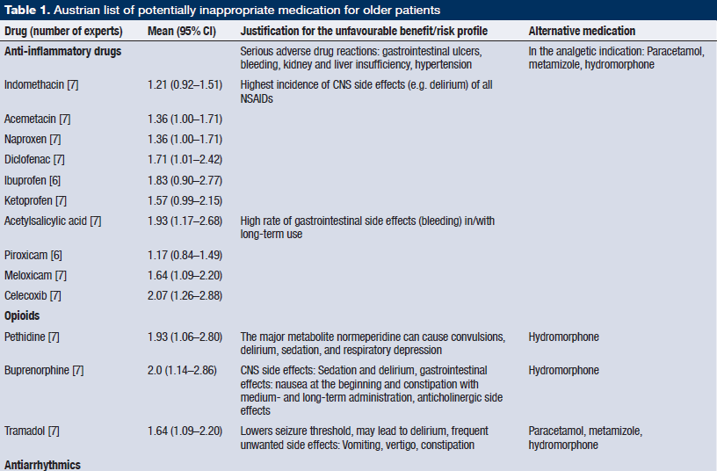
Austrian PIM List
Mann E, Böhmdorfer B, Frühwald T, Roller-Wirnsberger RE, Dovjak P et al.
Potentially inappropriate medication in geriatric patients: the Austrian consensus panel list. Wiener Klin. Wochenschrift. 2012;124(5–6):160–9
Notes:
National expert panel list in german-speaking-countries emerged because of significant differences in prescription habits between the countries. It tend to do the same job as the beer`s list, but is tailored for the national characteristics of prescription. Prescibing the reviewed drugs with marks in the backward manner you can estimate the value of each drug.

Slide 13
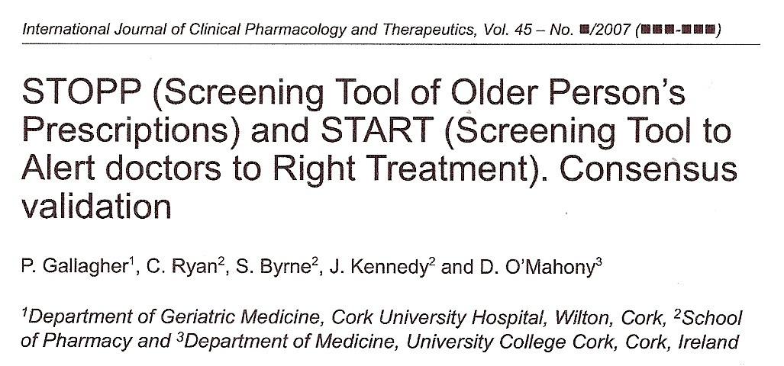
STOPP: 68 clinically relevant criteria for potentially inappropriate prescribing (PIM, Potentially Inappropriate Medication)
START: 22 evidence based indications for drug prescribing in frequent diagnoses of older patients
STOPP / START 2: Age and Ageing 2014; 0: 1–6 doi: 10.1093/ageing/afu145

Slide 14
STOPP / START
Gallagher P et al. Int J Clin Pharmacol Ther 2008 (46): 72-83

Slide 15
STOPP / START
Gallagher P et al. Int J Clin Pharmacol Ther 2008 (46):72-83

Slide 16
STOPP / START 2
O‘Mahony et al. Age Ageing 2015: 44: 213-218

Slide 17
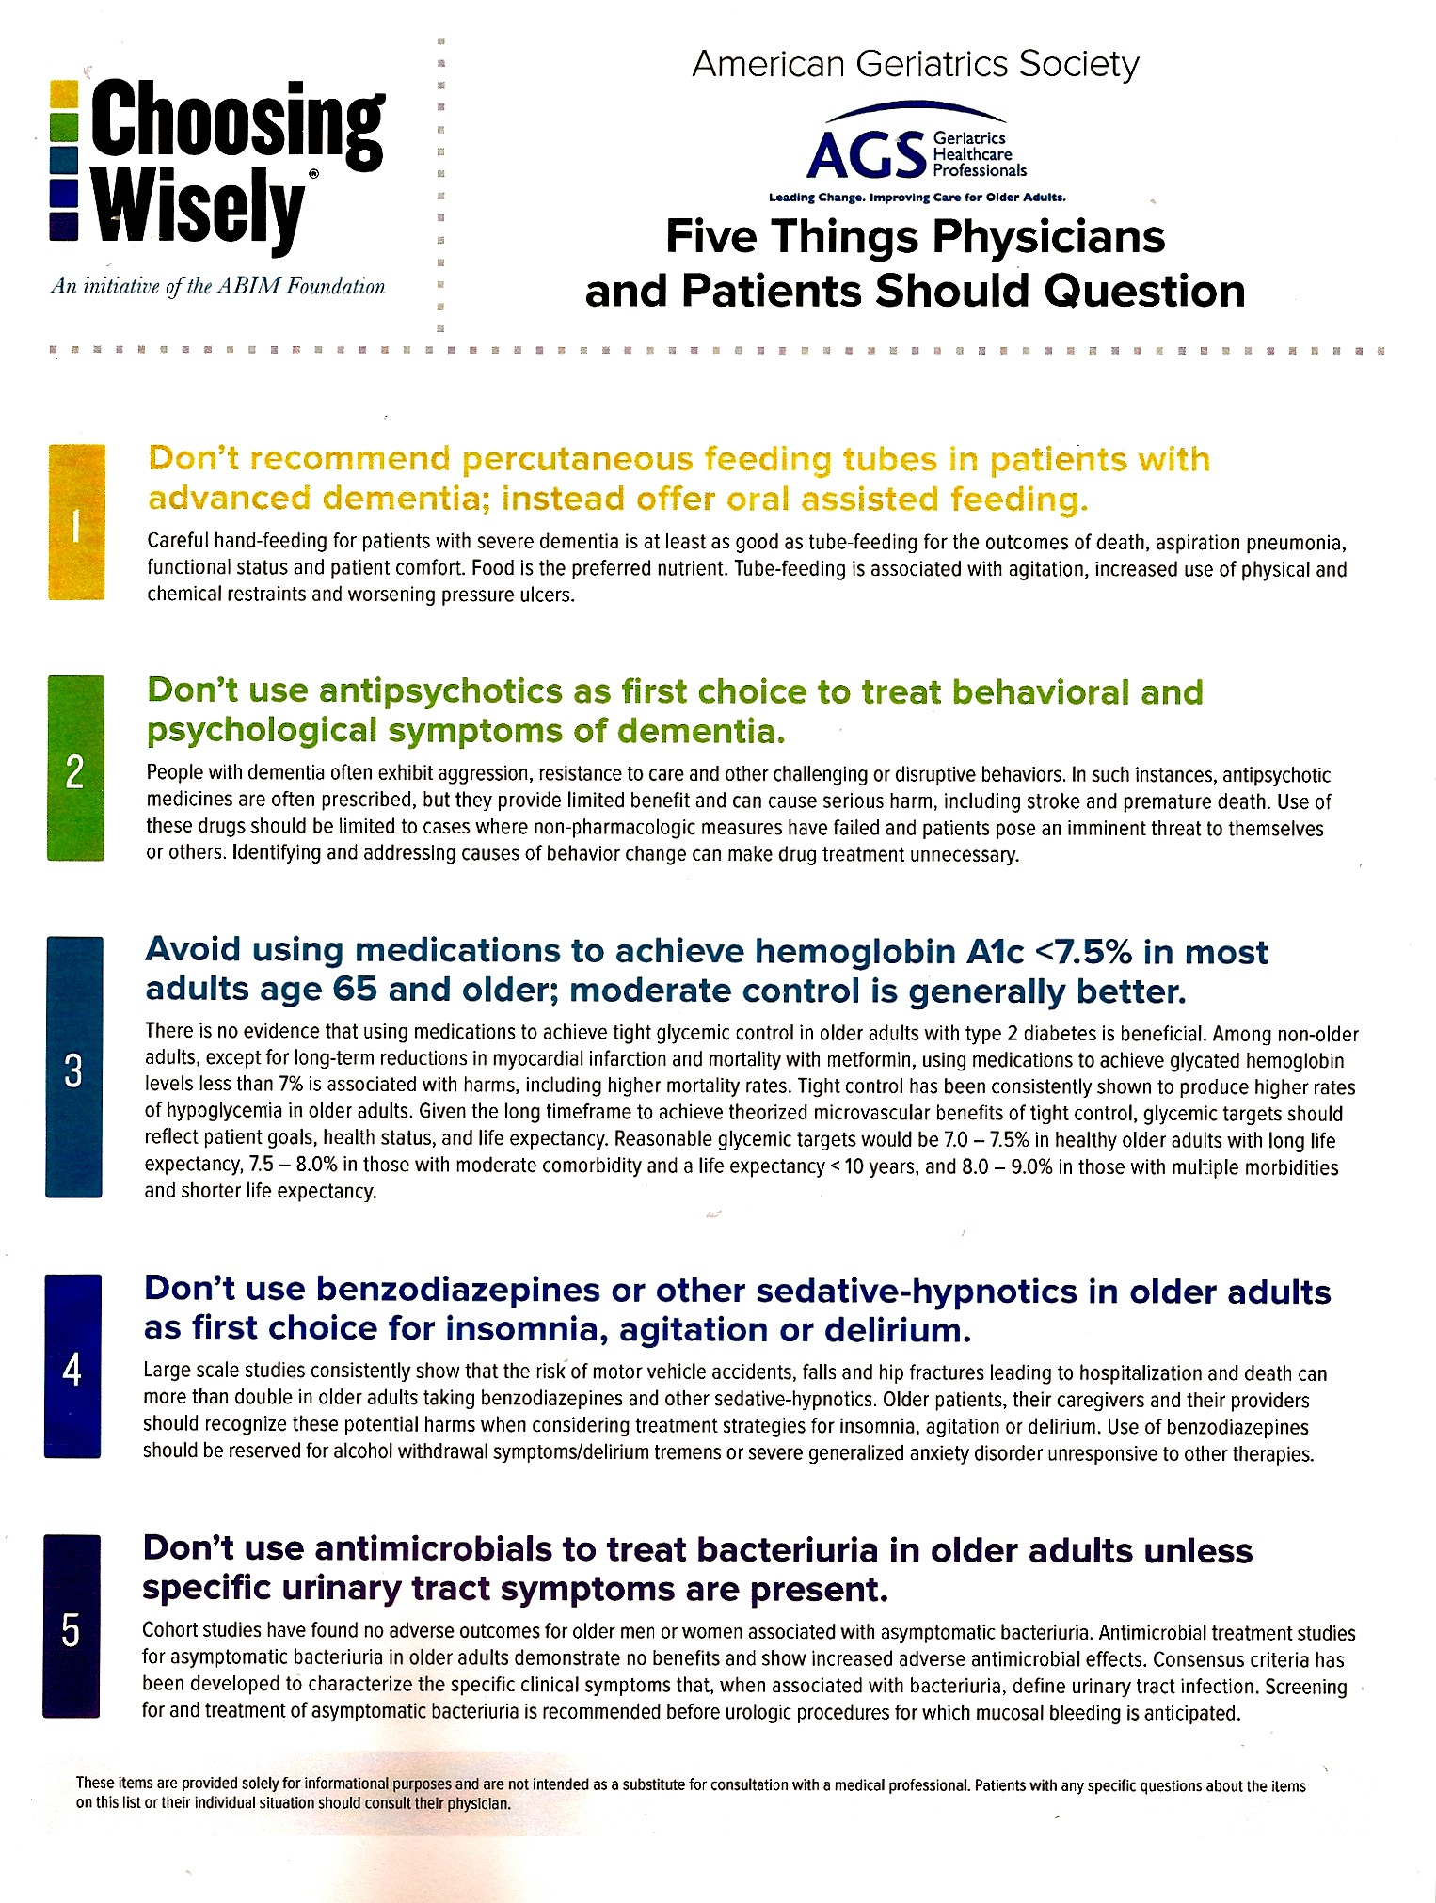
www.choosingwisely.org
Since 2013; 2023

Slide 18
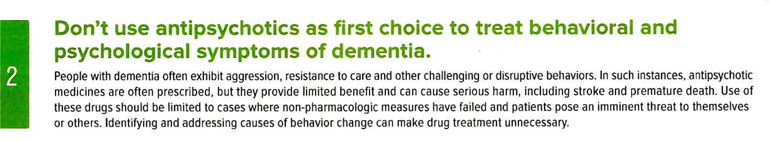


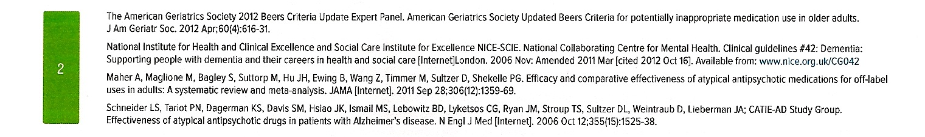

Slide 19
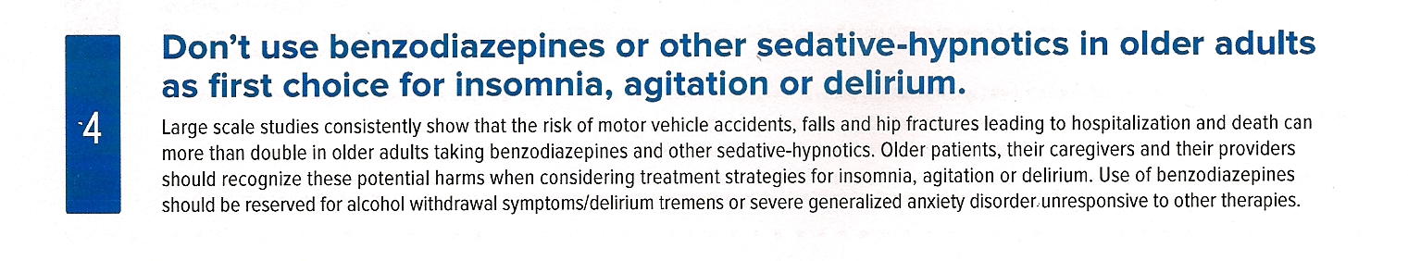
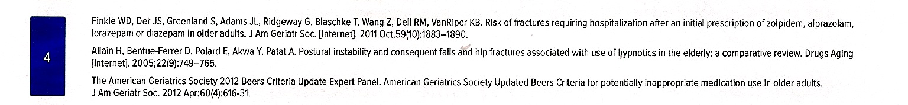

Slide 20
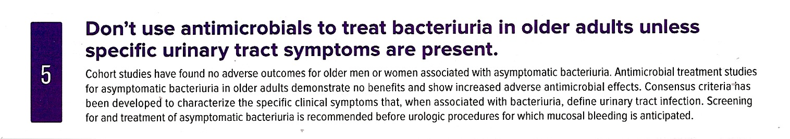
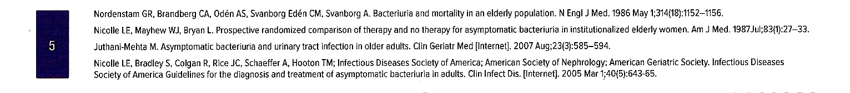

Slide 21


Slide 22
Danke!
<thofru@icloud.com>

